Slide 1
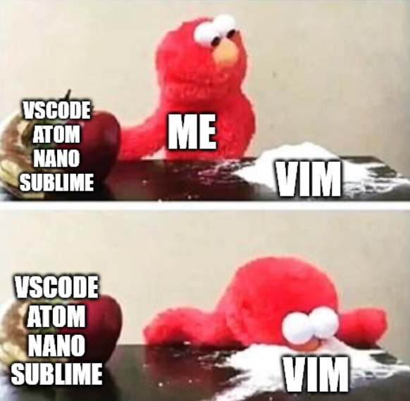

go brrr
Victor Kuo

Slide 2

About me
5th Year
Engineering (Space Mechatronics) + Science (Physics + Comp Sci)
Email: victor.kuo1@sydney.edu.au
Interned at Optiver (2019/20) and Atlassian (2020/21).
Tutor INFO1110, ENGG1810, MTRX1705
Languages: (In my order of preference!)
Python
HTML/CSS/Javascript/TypeScript (Web dev)
C++
C
Java
Assembly
Feel free to ask me anything!

Slide 3
The schedule tonight…
What is Vim?
Why use Vim?
Vim crash course
Tips to make Vim more useable!
Plugins
Computer settings
Tmux
Quality of life shell tweaks
Caveats
Closing

Slide 4
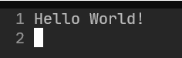
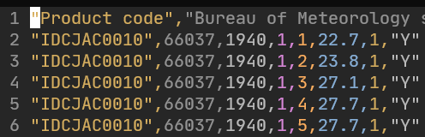
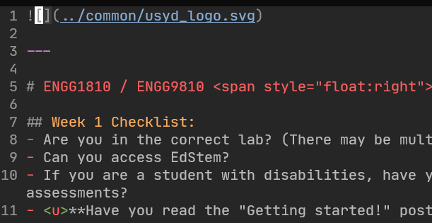
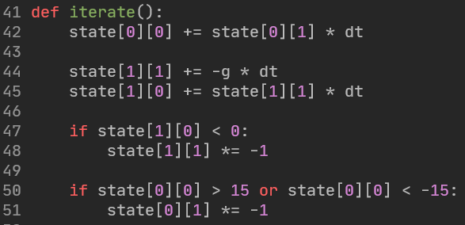
What is VIM?
A text editor!
Edits anything that is stored as raw text
E.g.
Text files
CSV files
Markdown files
Source code (no matter the language!)
Latex files
…
…
…

Slide 5

But what is a text file?
Raw text.
Letters, numbers, symbols, etc.
No images, fancy colouring, groupings, etc.
What about binary files?

Slide 6
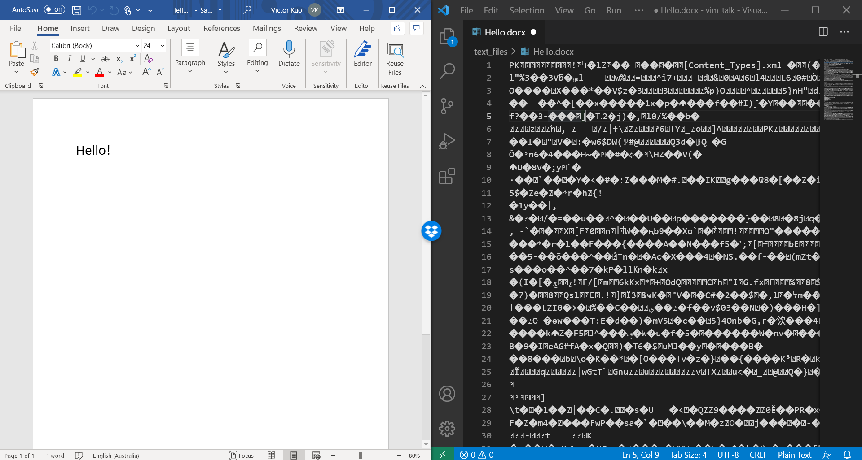

Slide 7
Why learn to edit text files when we have “better” software?
Text files:
Will never disappear.
Fully standardised across the world.
Viewable and editable by any format abiding editor.
Binary files:
Regularly change versions, format, styles, contents.
Hide away your actual contents in binary form.
You’re at the mercy of the software provider.
(This is not to say that binary files are bad, or that proprietary software is bad)

Slide 8








What is VIM?
A text editor!
Essentially, the same function as:

Slide 9
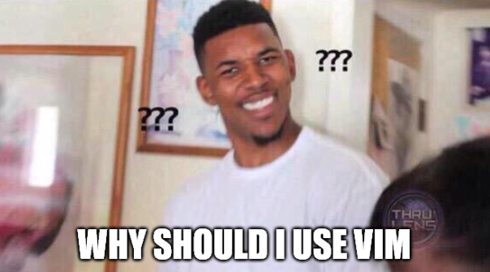
Notes:
Who wants to use regex!?
Middle click hold drag to multiline easier in VSCode.

Slide 10
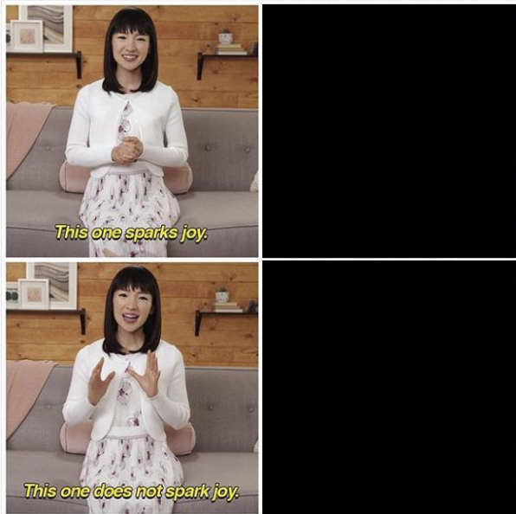







Slide 11
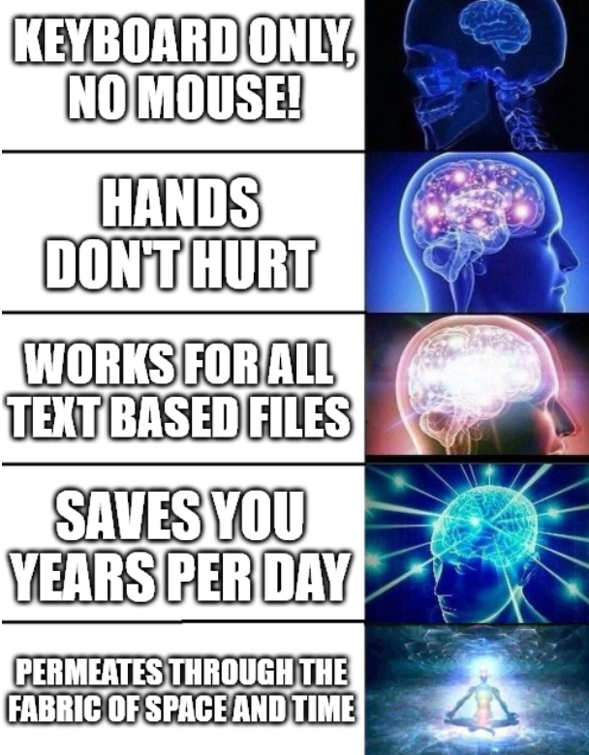
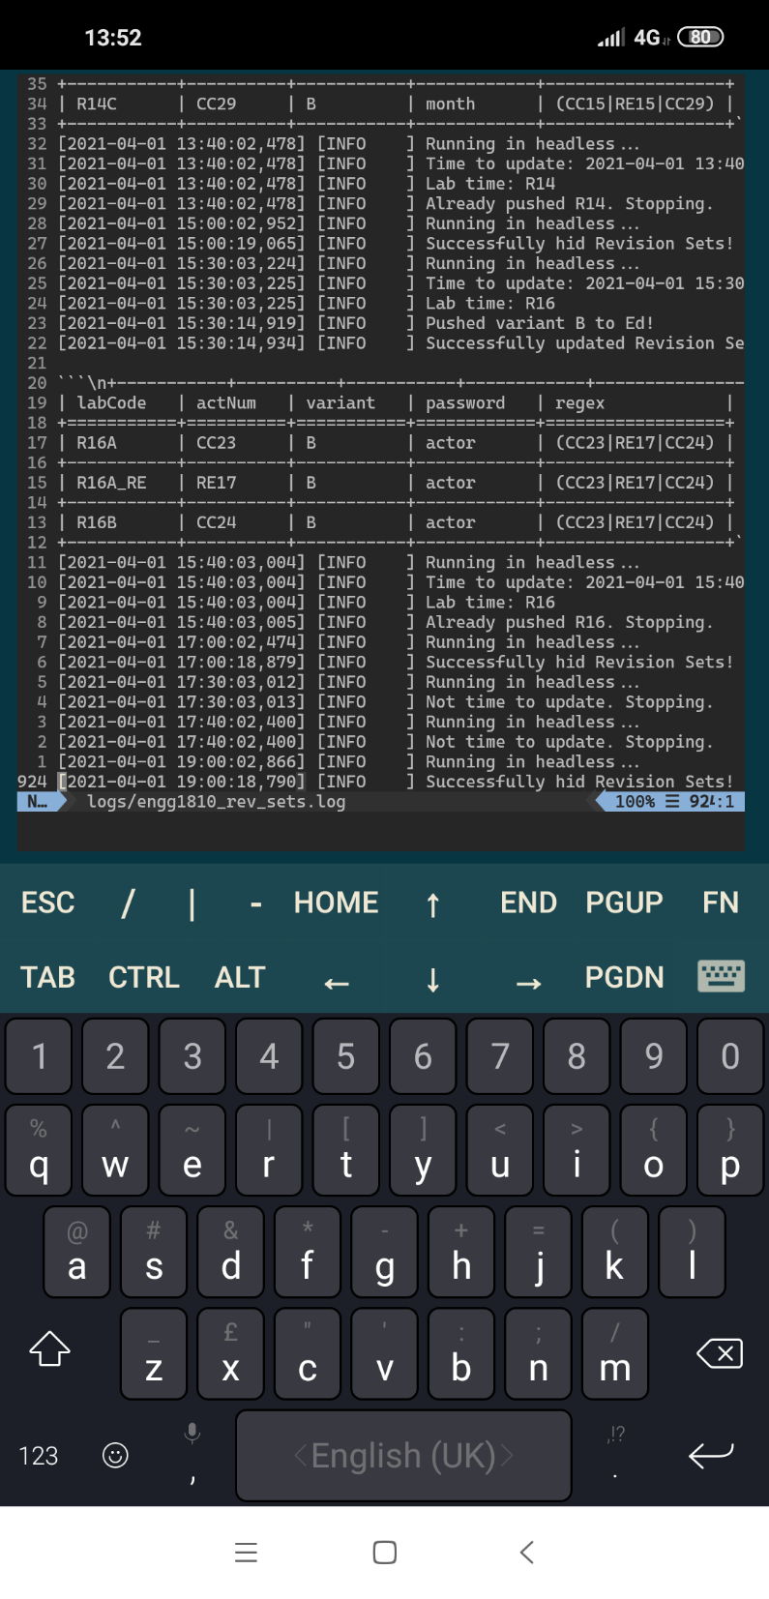
Notes:
Laptop coding is infinitely easier!
Much more intuitive! Commands make sense! Shortcuts make sense…

Slide 12
Let’s get started!

Slide 13
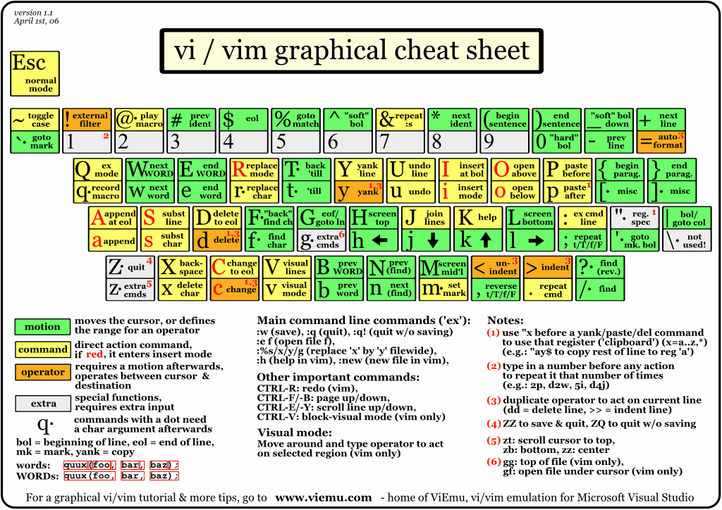
http://www.viemu.com/vi-vim-cheat-sheet.gif

Slide 14
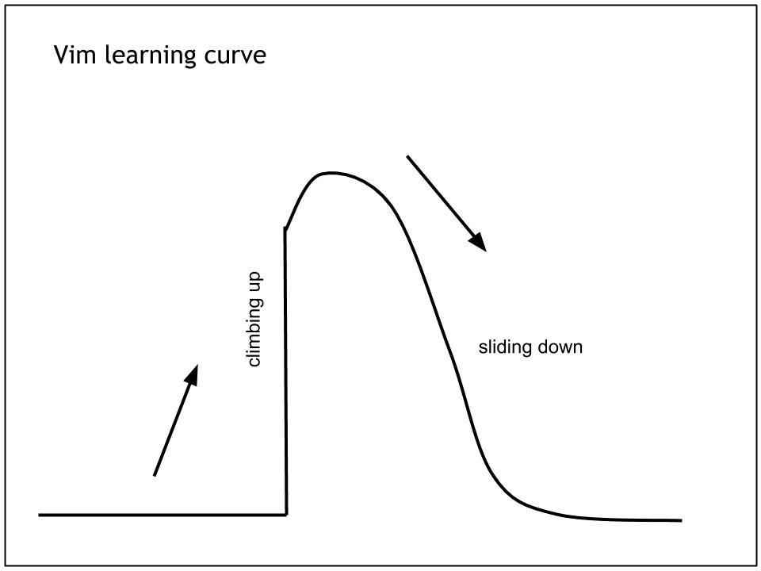
Exiting vim

Slide 15
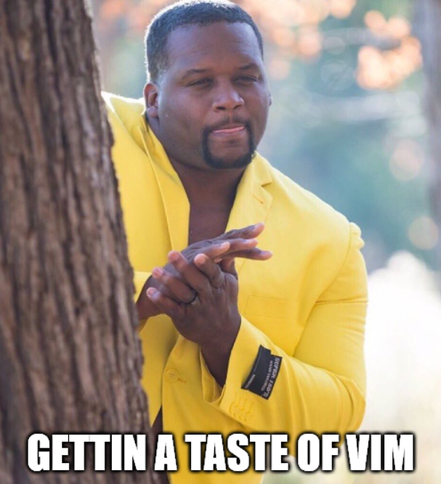
The goal tonight

Slide 16
How to get the most out of this talk…
Sit back, relax, and enjoy!
The goal is to give you guys exposure, to let you know what is out there.
Feel free to download these slides afterwards and try it out on your own ☺.
Taking notes or following along will drain you too quickly and you’ll miss what is really important! (imo at least)
Notes:
10:40m

Slide 17
Let’s actually get started…!
Notes:
18:40

Slide 18
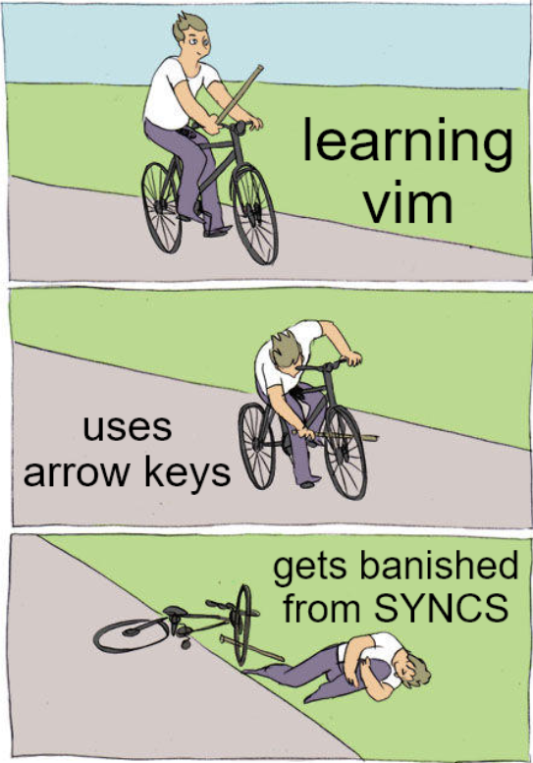

Slide 19
A great way to practise… Vim-be-good

Slide 20
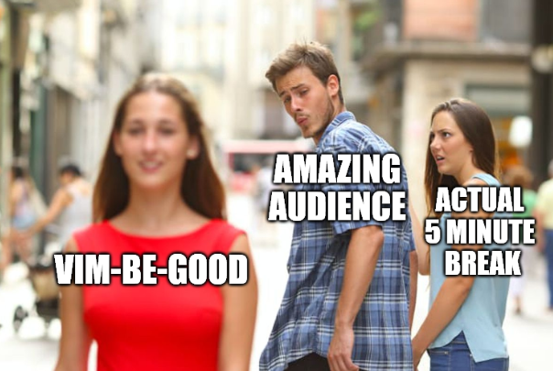
5 minute break!
First 5 people can try VIM-BE-GOOD!
Notes:
23:40

Slide 21
More complex Vim…
Notes:
38:40

Slide 22
5 minute break!
Next 5 people can try VIM-BE-GOOD!
Notes:
43:40

Slide 23
Tips before learning Vim yourself
Remap caps lock to be ctrl
Your fingers will thank you for this!
Remap leader to space
Leader is the prefix to a lot of your user defined commands.
Increase the key repeat rate
You don’t want to be here for years, right?
Decrease the key repeat delay (to start the repeat)
Same as above… lol.
Don’t get banished from SYNCS (unbind the arrow keys if you’re tempted!
Notes:
46:40

Slide 24
Plugins
Recommended:
Plug 'junegunn/fzf', { 'do': { -> fzf#install() } } " fuzzy find
Plug 'junegunn/fzf.vim'
Plug 'morhetz/gruvbox'
Plug 'tpope/vim-commentary'
Plug 'preservim/nerdtree'
Plug 'tpope/vim-surround'
Plug 'jiangmiao/auto-pairs'
<your language syntax highlighter>
<Intellisense recommend COC>
Notes:
48

Slide 25
Other niceties…

Slide 26
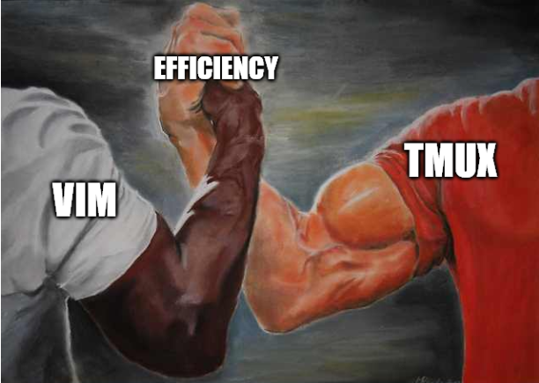
Vim & Tmux
Notes:
51

Slide 27
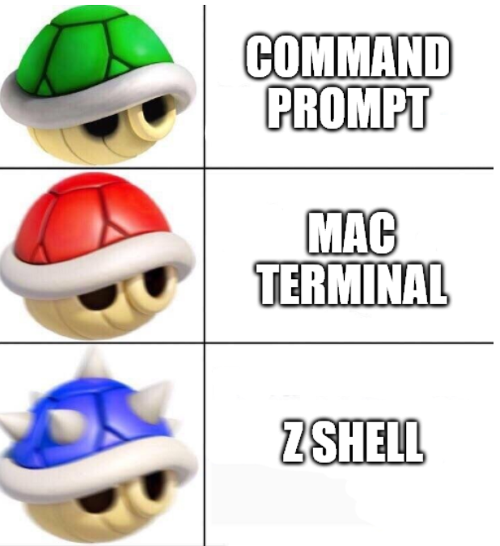
Zsh
A better shell.
Works on Linux, Mac, Windows (WSL)…!
Autocomplete
Git shortcuts
Notes:
53

Slide 28

Vim in the browser!?!? (Vimium)

Slide 29

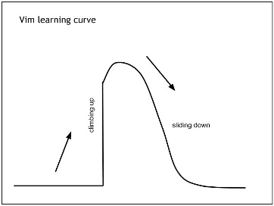
Caveats to using Vim
Live debugging is hard… but there are other ways around it…
Installing your vim plugins and config on a new machine takes a bit longer than installing a single VSCode installer.
Massive productivity drop at the start.
Learning all the basic shortcuts takes time…
Learning all the plugins takes time…
Configuring your new keymaps takes time…
Notes:
60

Slide 30
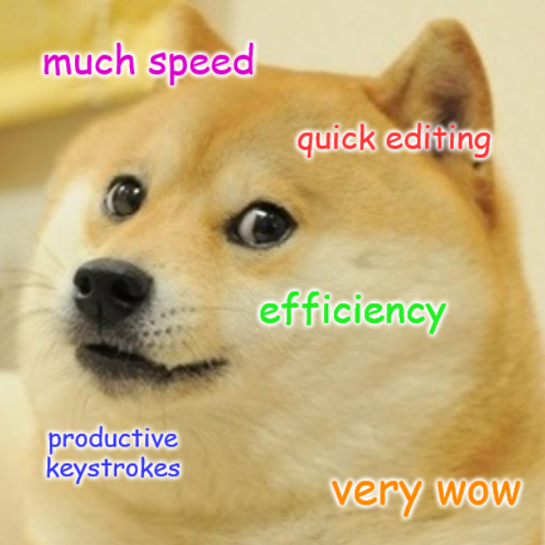
Closing
Vim is HARD to get started with.
But it’s a long term investment on your hands (and girlfriend 😉).
Always look for easier ways to do things.
Once you see the light, once you come out of the other side of the tunnel, you will emerge a new, woke coder.
Notes:
65

Slide 31
Further study
`vimtutor`
This talk’s recording
Repo: https://github.com/vck3000/vim_talk_v1
The Primeagen
https://vim-adventures.com/
Vim talk v2 ??

Slide 32
Thank you for listening!
Q&A time

